Slide 1
Heredity Notes Biotechnology and genetic techniques
DNA Identification techniques and how that are applied in agriculture and conservation
Gene probe & microarray
DNA Sequencing

Slide 2
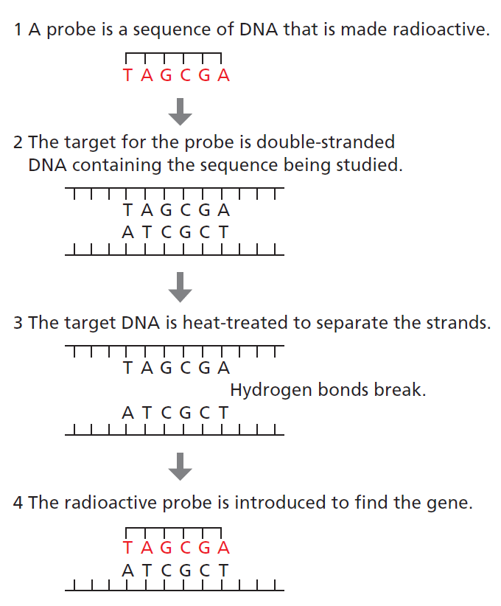
Syllabus:
Recombinant DNA technology and DNA identification technologies are applied in agriculture and environmental conservation
Identify & describe techniques that can be used in DNA identification and how these technologies can be applied in agriculture and environmental conservation
Heredity
Essential
Question:
BIOLOGY WA UNITS 3&4
Chapter 6 Biotechnology- Its Tools and Techniques pg. 169-198
Set 6.2 pg. 174 Q1-6 DNA TOOLS USED IN BIOTECHNOLOGY
Set 6.3a pg. 180 Q1-7 DNA TECHNIQUES & VOCAB AND PCR
Set 6.3b pg. 183-184 Q1-6 GEL ELECTROPHORESIS
Set 6.3c pg. 185 Q1-5 MICROARRAYS
Set 6.4a pg. 190 Q1-5 DNA SEQUENCING
Set 6.4b pg. 191 Q1-5 GENOME MAPPING USING DNA SEQUENCING
BIOZONE Activity Number:
GEL ELECTROPHORESIS 145, 146,
APPLICATIONS OF BIOTECH 151, 152,
DNA SEQUENCING 153, 154,
TERMINOLOGY 162
Topic Question 1:
Describe how a gene probe can be used to identify DNA

Slide 3
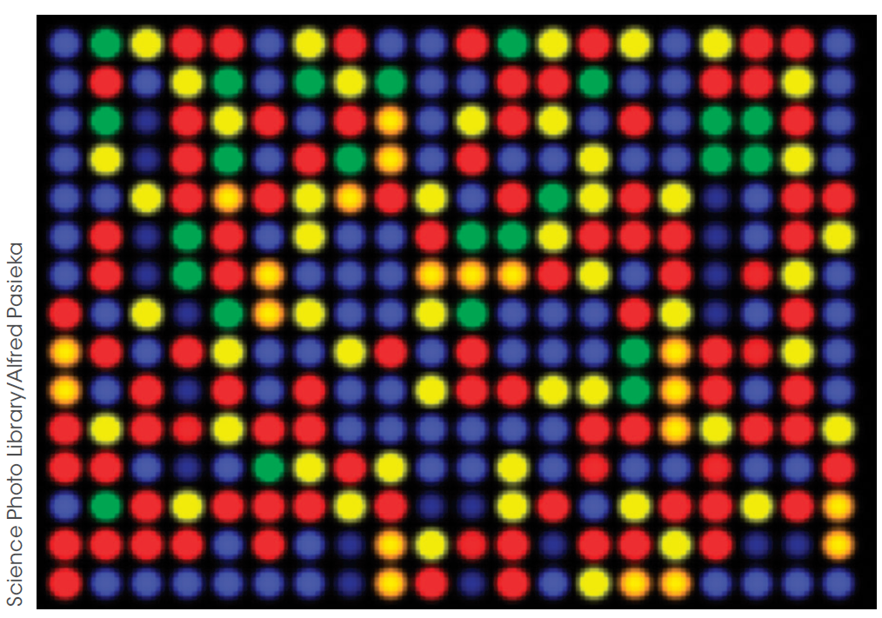
Topic Question 2:
Describe how a gene probe can be used to create a microarray
Topic Question 3:
Describe the purpose of a microarray

Slide 4
Topic Question 4:
Describe how microarrays can be useful ​
Topic Question 5:
Define DNA Sequencing

Slide 5
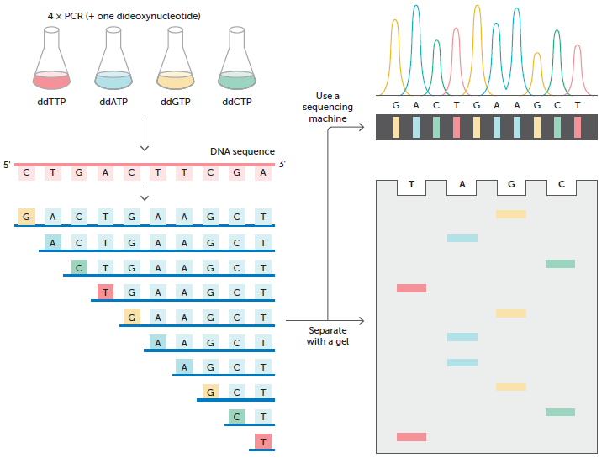
Sanger Method (steps)
METHOD 1 – Sanger Method or Dideoxynucleotide Sequencing
Topic Question 6: Identify and describe the technique/s used by researchers to sequence genes/genomes

Slide 6
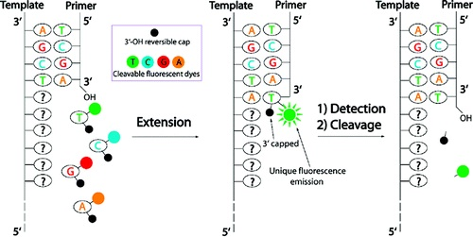
Topic Question 6: Identify and describe the technique/s used by researchers to sequence genes/genomes
Method 2 – Next-generation sequencing

Slide 7
Topic Question 7: Describe the applications of DNA Sequencing
Read page 188 – 191, 216 – 217, 224 – 231 Biology WA ATAR Units 3 & 4
BIOZONES: 152, 153, 154

Slide 8
SUM IT UP!
Contrast Sanger Sequencing and new generation sequencing.
Create a flow diagram of Sanger Sequencing
Define the terms gene probe and microarray and describe the purpose of microarray

